Slide 1
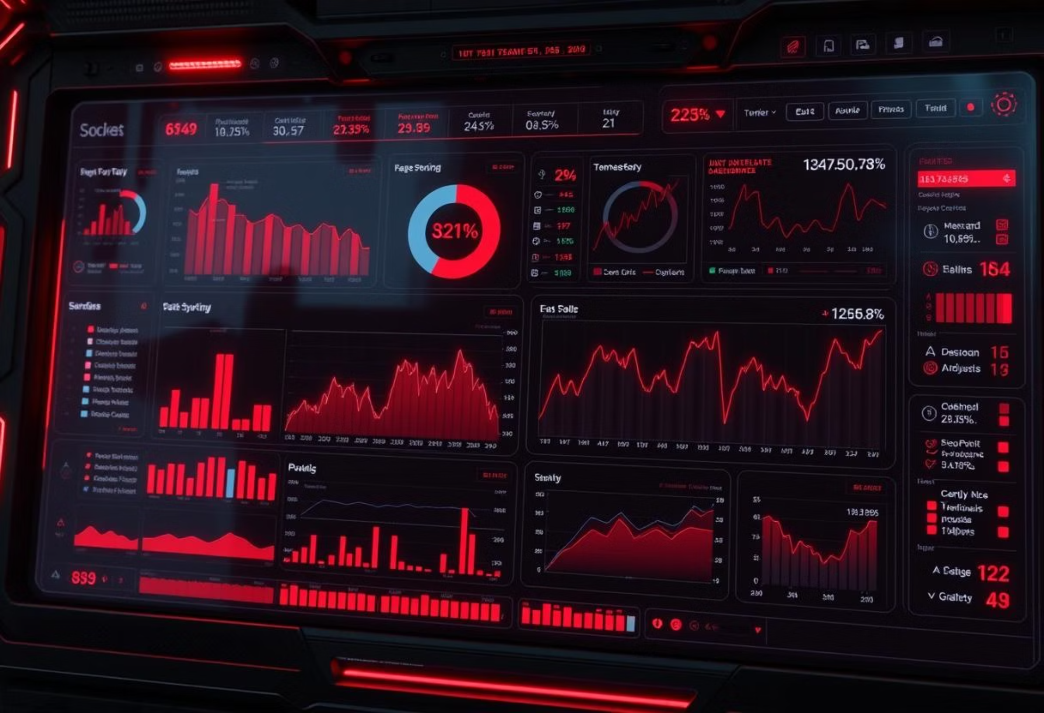
Electronic Sales Performance Dashboard (2017-2023)
Data-Driven Insights for Business Decisions

Slide 2
Executive Summary
This presentation outlines a comprehensive dashboard design for electronic sales data from 2017-2023, providing key findings at a glance to support strategic business decisions.
Total Sales Volume
Growth Trends
Performance Periods
Overall sales performance over the period.
Identification of key periods of growth and decline.
Highlighting best and worst performing months/years.

Slide 3
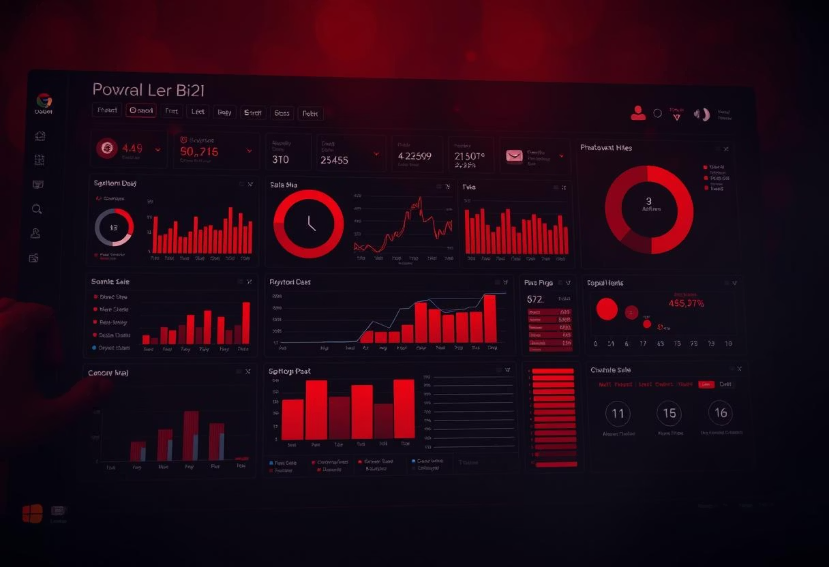
Dashboard Overview
The dashboard integrates various components to offer a holistic view of electronic sales performance, ensuring data is easily accessible and actionable.
It features interactive elements for detailed analysis and a consistent dark theme for optimal visibility.

Slide 4
Key Performance Indicators (KPIs)
Our dashboard prominently displays critical KPIs, offering immediate insights into sales health and performance drivers.
₹1.2M
+15%
₹100K
Dec
Total Sales
YoY Growth Rate
Avg. Monthly Sales
Best Month
Sum of all sales transactions.
Percentage change from the previous year.
Month with the highest sales.
Average sales volume per month.
Apr
Worst Month
Month with the lowest sales.

Slide 5
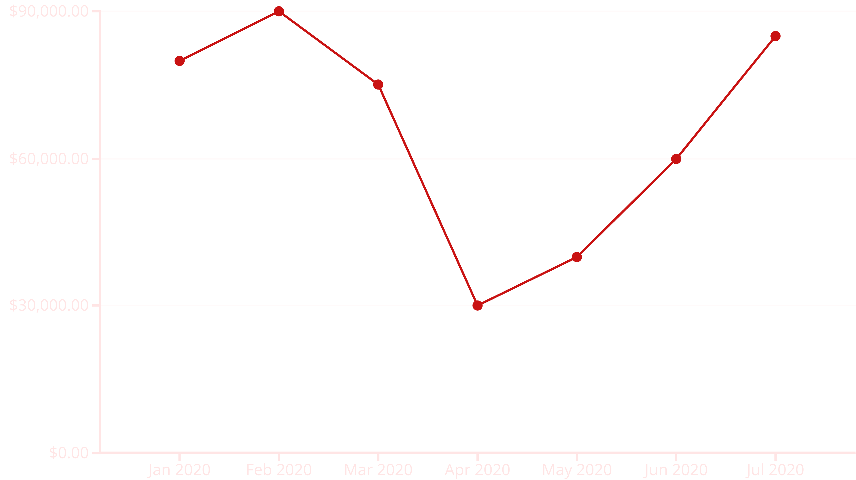
Sales Trend Analysis
A line chart visualises monthly sales trends, allowing users to toggle between yearly and quarterly views. This helps identify patterns and anomalies over time.
The chart highlights the significant impact of COVID-19 during April-May 2020, followed by a recovery period.

Slide 6
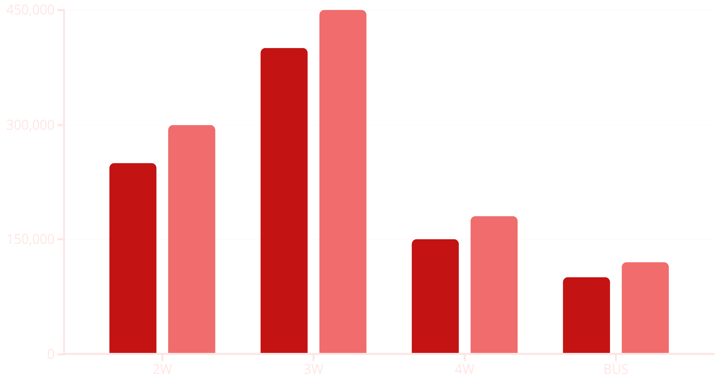
Product Category Performance
A stacked column chart illustrates the contribution of each product category (2W, 3W, 4W, BUS) to overall sales, with percentage breakdowns.
2022 Sales
2023 Sales
Insights reveal dominant categories like 3W and emerging trends such as 2W growth in recent years.

Slide 7
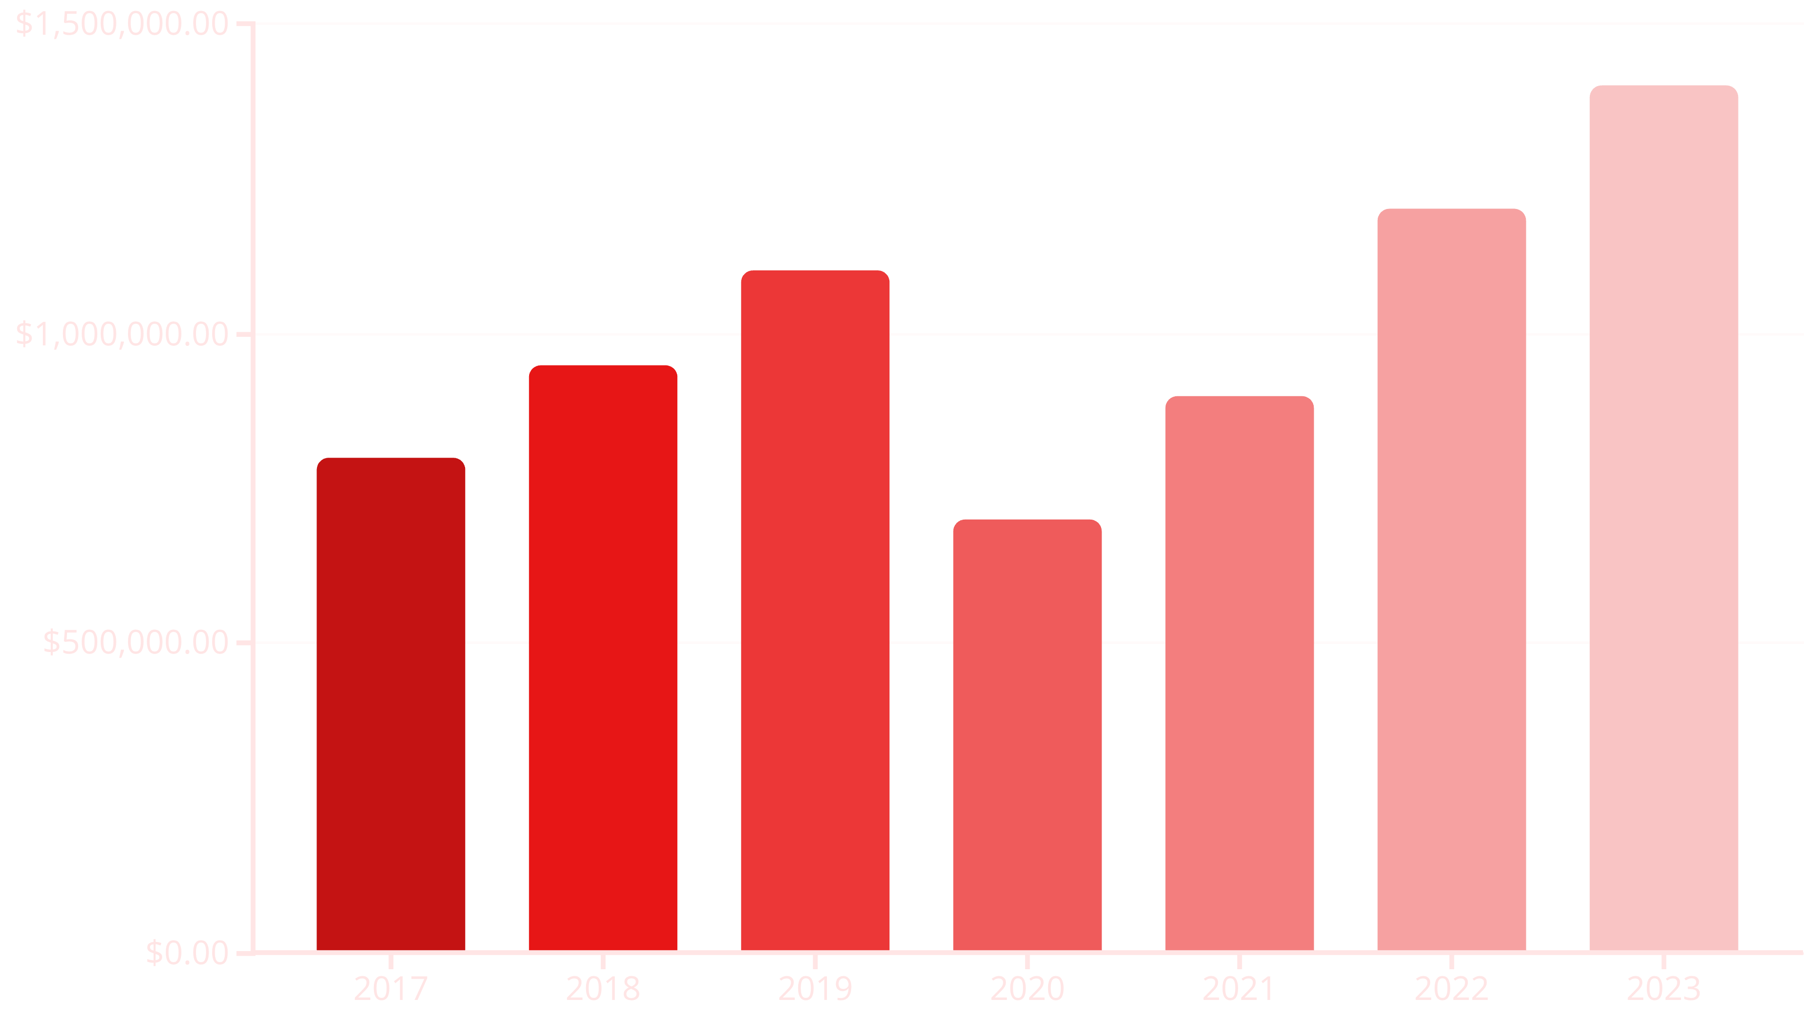
Year-over-Year Comparison
This section provides a side-by-side comparison of annual sales totals with growth rate indicators, offering clear insights into business expansion.
Key takeaways highlight periods of significant growth and the overall trajectory of the business.

Slide 8
COVID Impact Analysis (April-May 2020)
This dedicated analysis focuses on the severe impact of the COVID-19 pandemic on sales during April-May 2020, detailing the percentage drop and recovery timeline.
Significant Drop
Recovery Timeline
Lessons Learned
Sales experienced a substantial decline during the initial lockdown period.
Tracking the gradual rebound in sales post-lockdown.
Insights gained for future crisis management and business resilience.

Slide 9



Recent Performance (2022-2023)
An in-depth look at current year trends, comparing performance with previous years and projecting future growth.
Current Trends
Historical Comparison
Growth Projections
Analysis of sales patterns and market shifts in 2022-2023.
Benchmarking against prior years to identify sustained growth or new challenges.
Forecasting future sales based on current momentum and market conditions.

Slide 10
Business Recommendations & Next Steps
Based on the dashboard insights, we propose actionable recommendations for growth and risk mitigation, along with future enhancements for the dashboard.
Suggested Actions
Future Enhancements
Optimise inventory based on category performance.
Integrate customer feedback data.
Target marketing efforts to emerging categories.
Add predictive analytics for sales forecasting.
Develop contingency plans for market disruptions.
Expand to include regional sales performance.

